Slide 1
10 Security Concepts You Must Know (in 5 minutes with GoT)
Toni de la Fuente, CISSP
Lead Security Operations

Slide 2
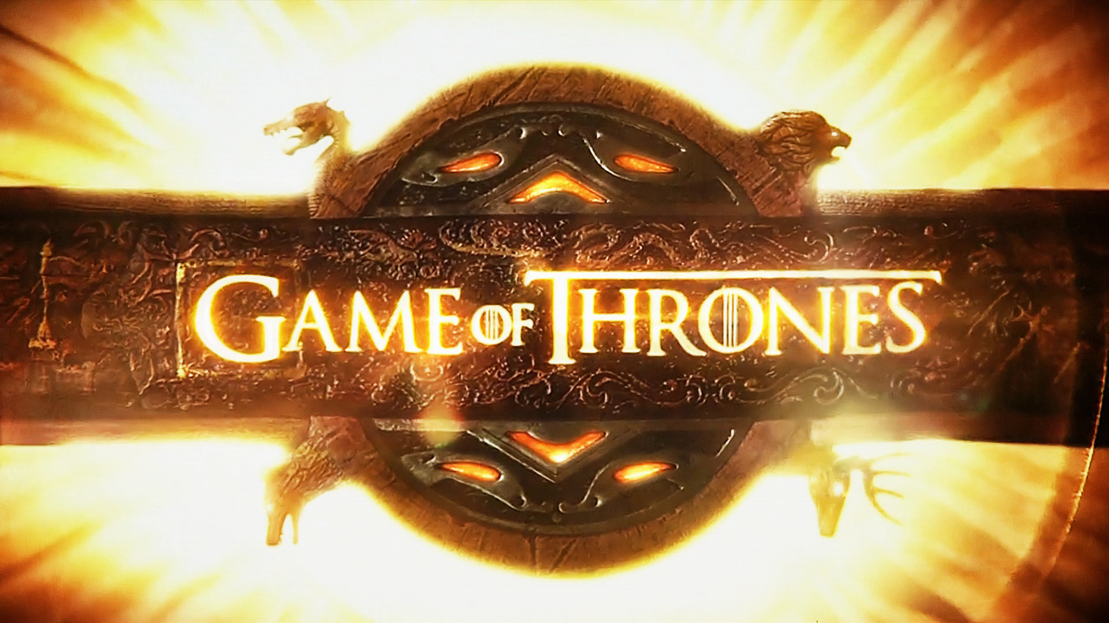
But based on…
Spoiler is coming...

Slide 3
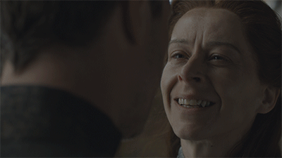
1. Vulnerabilities vs. exploits
A vulnerability is a weakness that may allow an attacker to compromise a system. Vulnerabilities usually happen due to bad code, design errors, or programming errors.
An exploit is code that exploits the vulnerability
Notes:
Littlefinger / Lysa Arryn

Slide 4
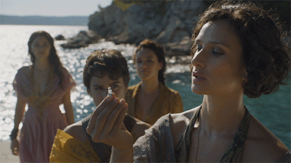
2. Zero-day vs. known vulnerabilities (CVE)
Zero-day: new vulnerabilities before they’ve been publicly revealed and fixed. Are the most dangerous.
Known vulnerabilities: Common Vulnerabilities and Exposures (CVE) system, by MITRE.
Notes:
Ellaria Sand, Myrcella Baratheon
Ellaria poisoned Myrcella with the kiss of death.
antidote

Slide 5
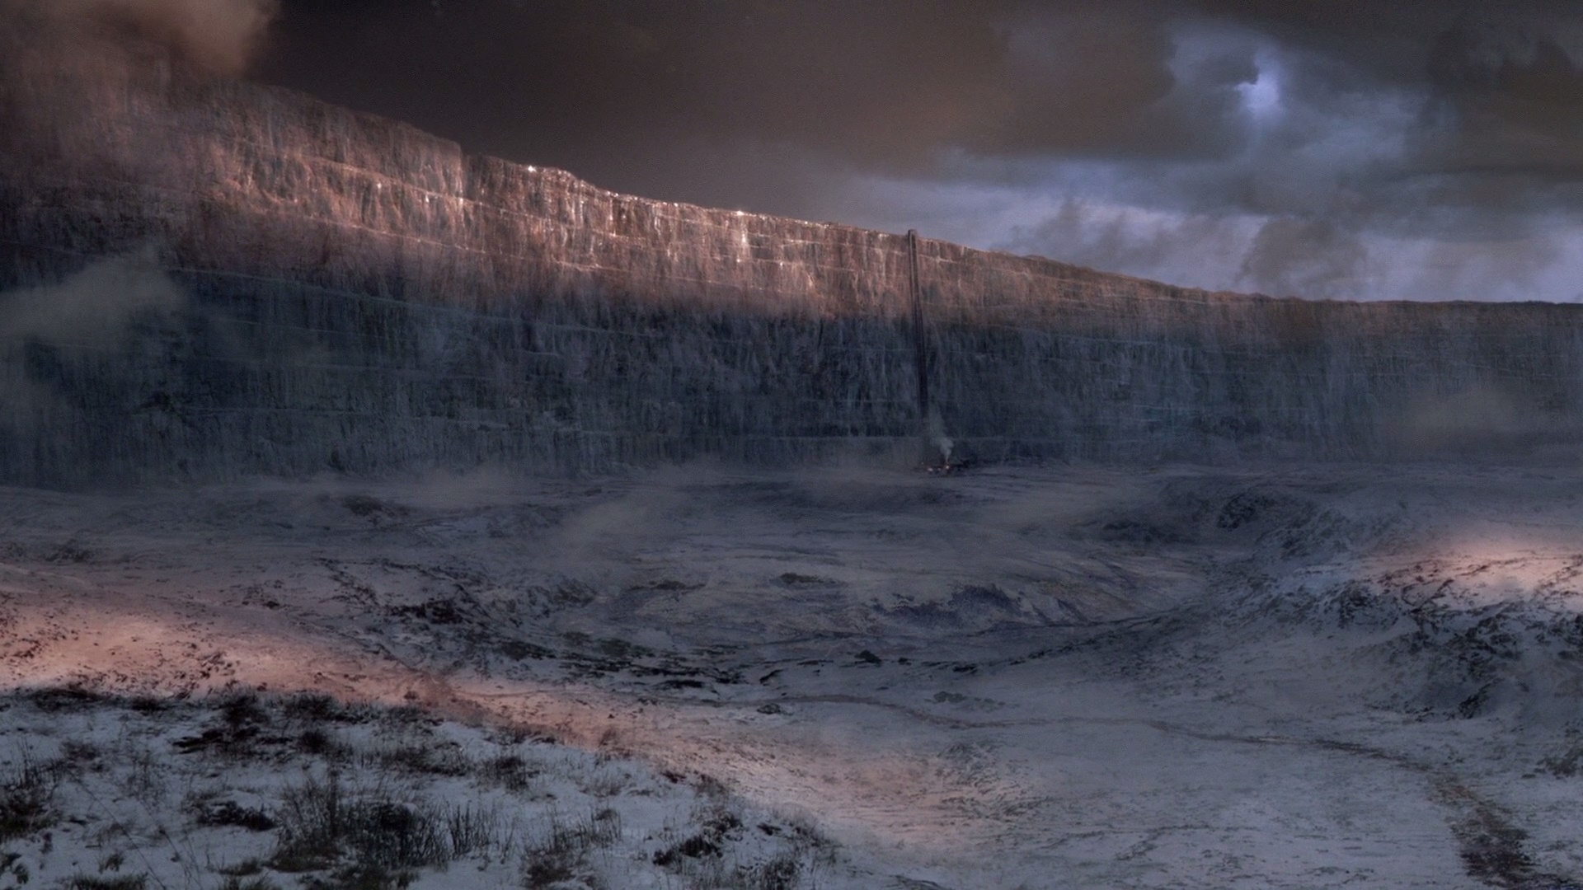
3. Attack surface
All the possible entry points into a system through which an attacker could gain access
Notes:
The Wall is defended and held by the Sworn Brothers of the Night's Watch.
Defending the seven kinddoms from wildlings and while walkers

Slide 6
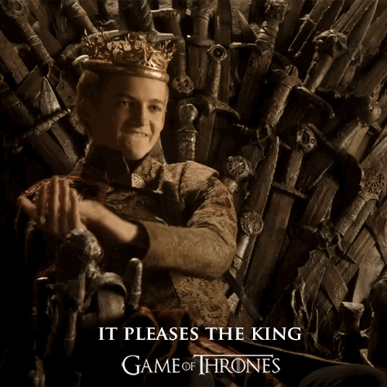
4. Least-privilege principle
Users and application components should only have access to the minimum information and resources they need, in order to prevent both accidental and deliberate system misuse.
Notes:
Joffrey Baratheon

